Slide 1

Lightning talk
“My journey as a ClickHouse beginner”
By: Tsvetan Stoychev

Slide 2
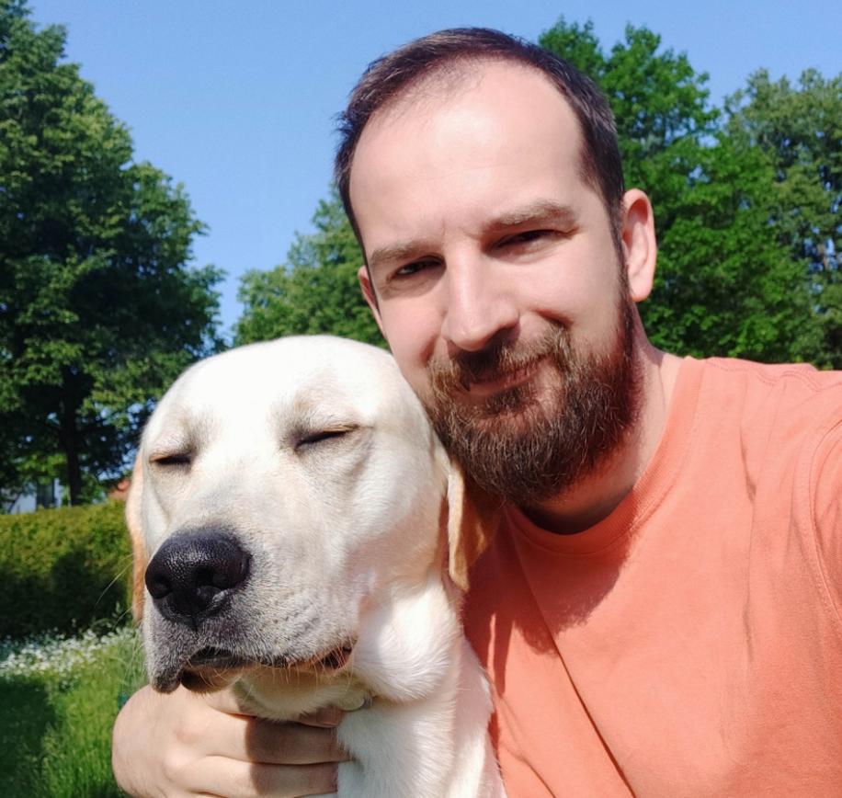
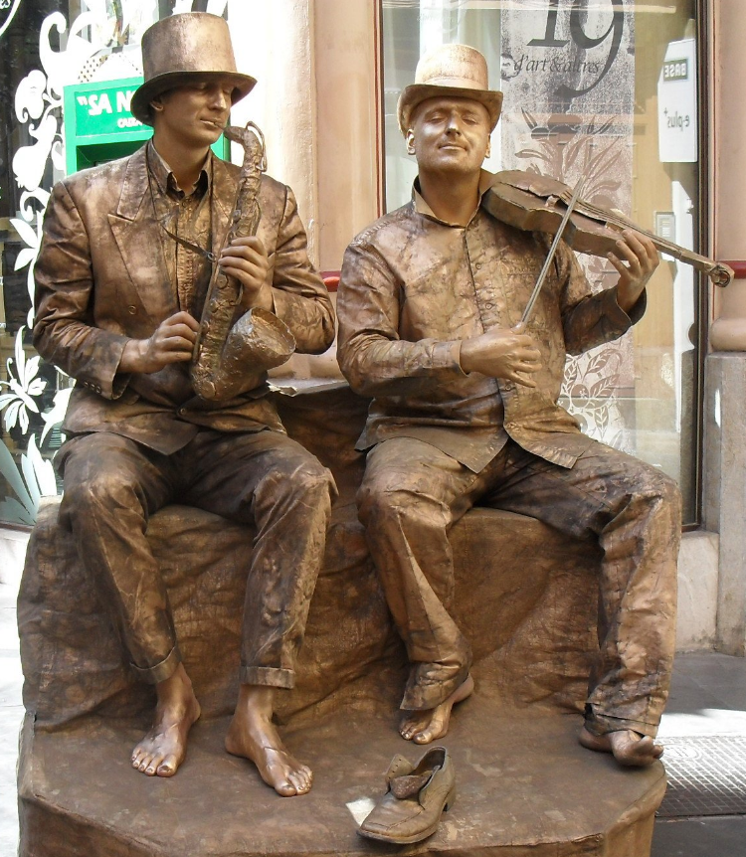
About me / hobbies
I love to walk with Lucky
I do street art

Slide 3


About me / work
I work at
I use ClickHouse for
a hobby project

Slide 4
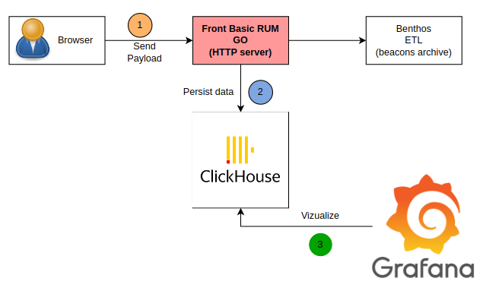
Basic RUM in general

Slide 5
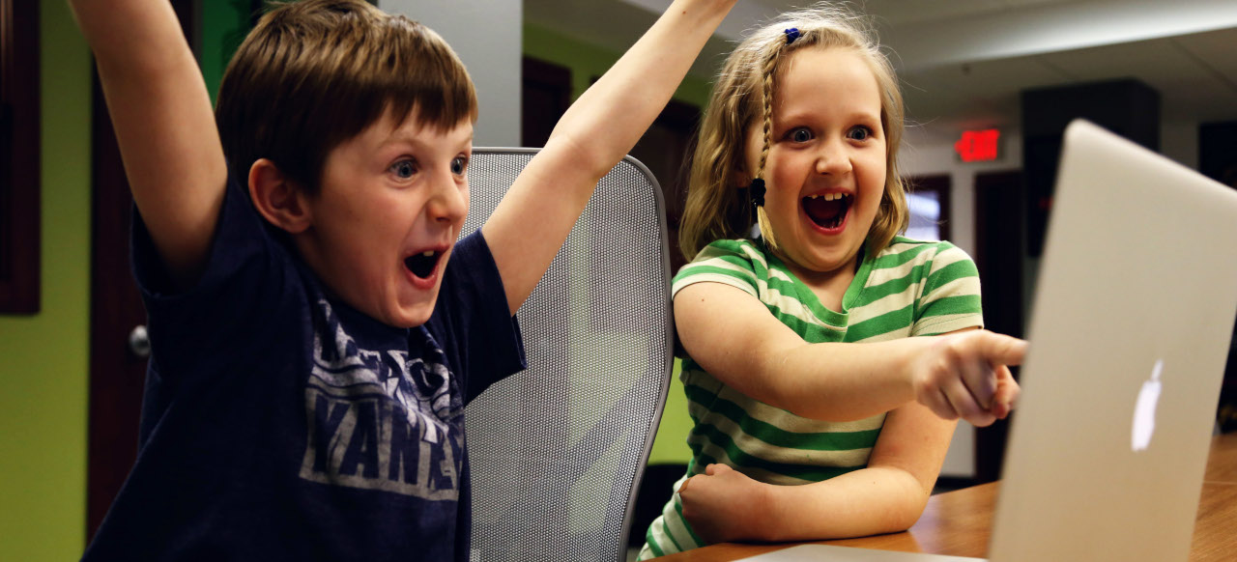
I am a ClickHouse
Script Kiddie

Slide 6

Script kiddie
Wikipedia
“A script kiddie, skiddie, or skid is a relatively unskilled individual who uses scripts or programs, such as a web shell, developed by others to attack computer systems and networks and deface websites, according to the programming and hacking cultures.”

Slide 7


What I need as ClickHouse beginner?
(1) Playground for experiments
(2) Study/Access to information

Slide 8
(1) Playground for experiments

Slide 9
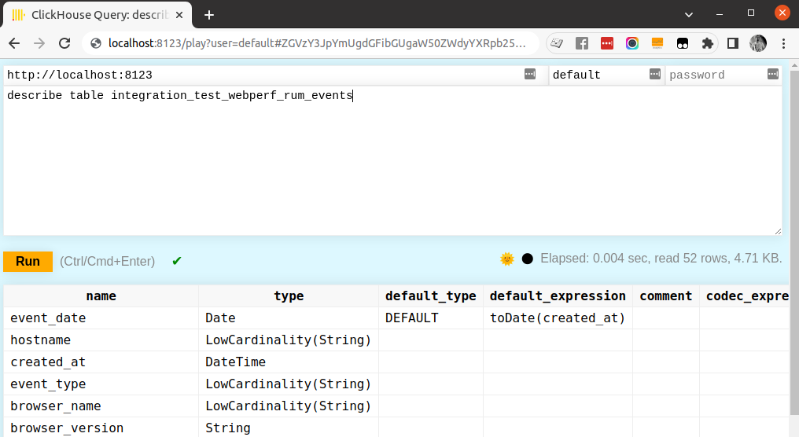
(1) Playground for experiments

Slide 10
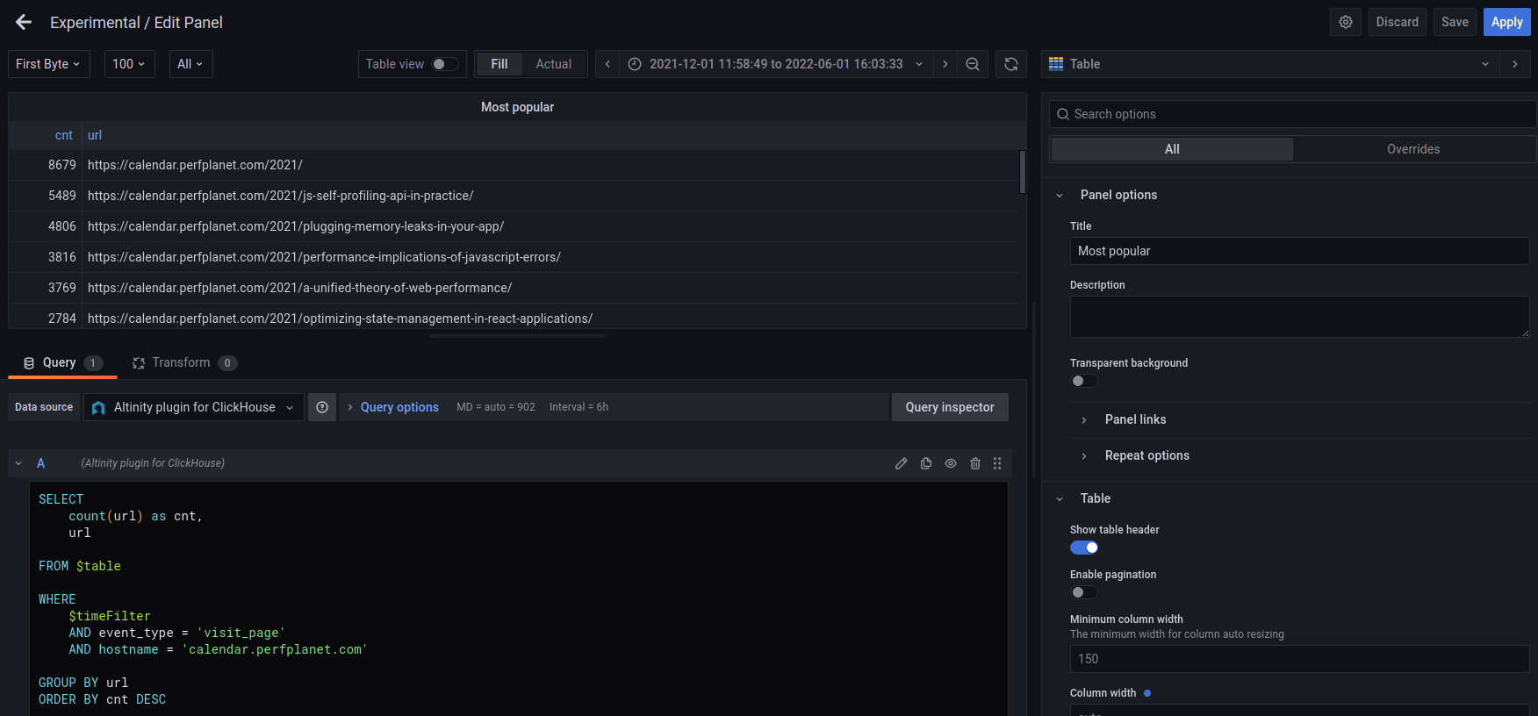
(1) Playground for experiments
Grafana as a playground
4
3
3
1
2

Slide 11
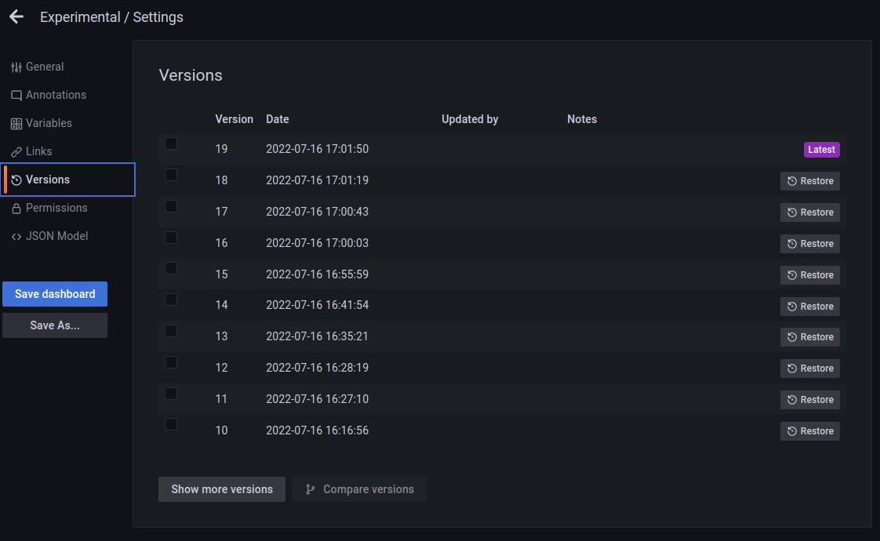
(1) Playground for experiments
Grafana as a playground

Slide 12
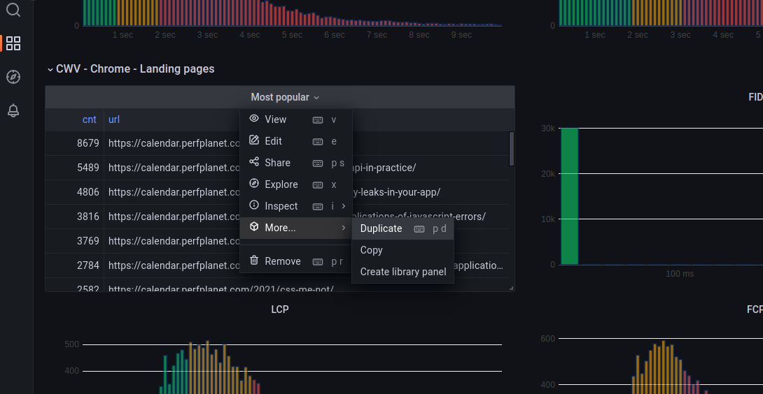
(1) Playground for experiments
Grafana as a playground

Slide 13
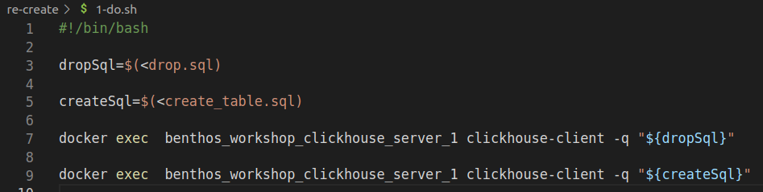

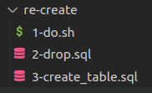
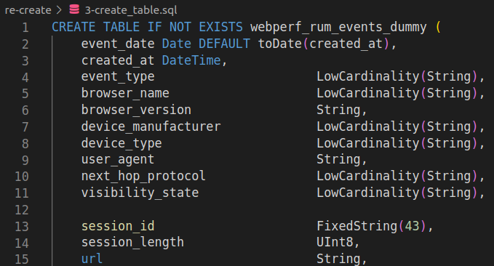
(1) Playground for experiments
1
2
3

Slide 14
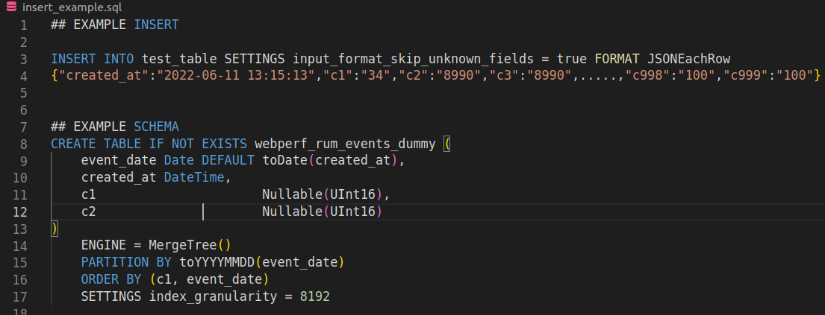
(1) Playground for experiments

Slide 15
(2) Study/Access to information

Slide 16
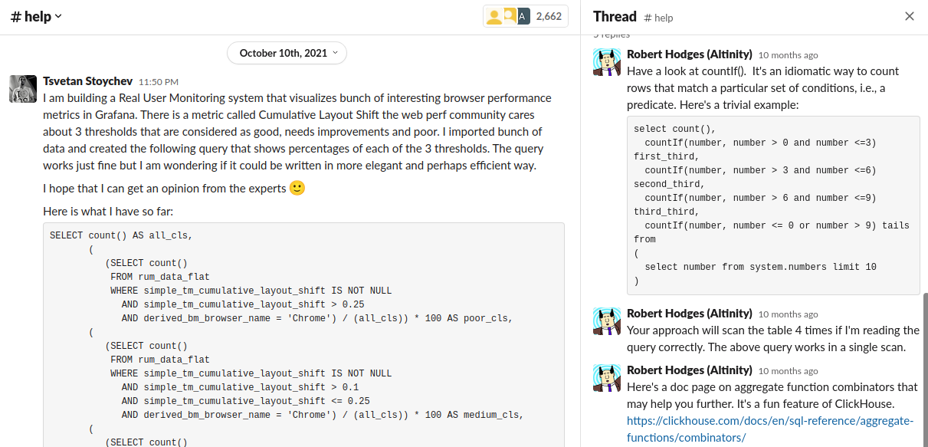

(2) Study/Access to information
Really good support on the ClickHouse slack space!

Slide 17
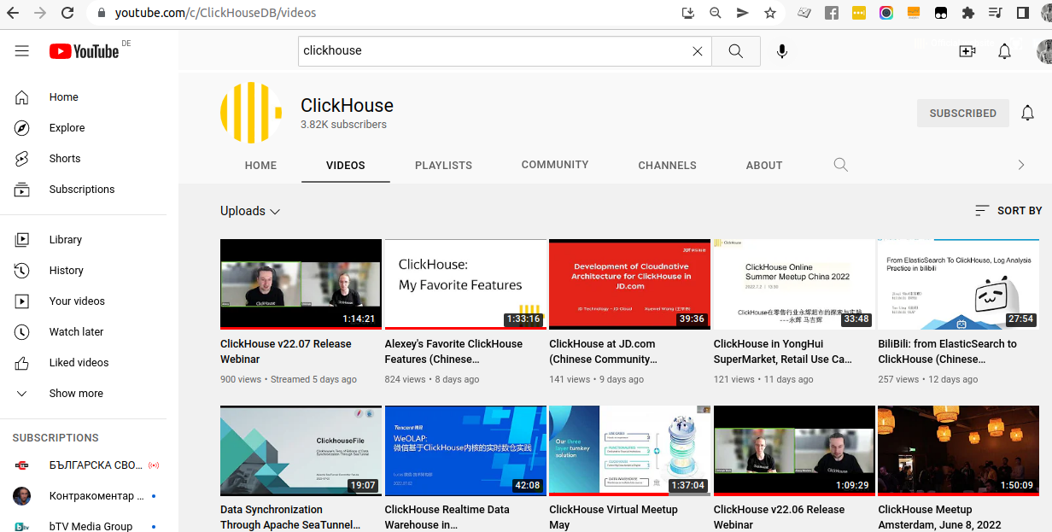
(2) Study/Access to information

Slide 18
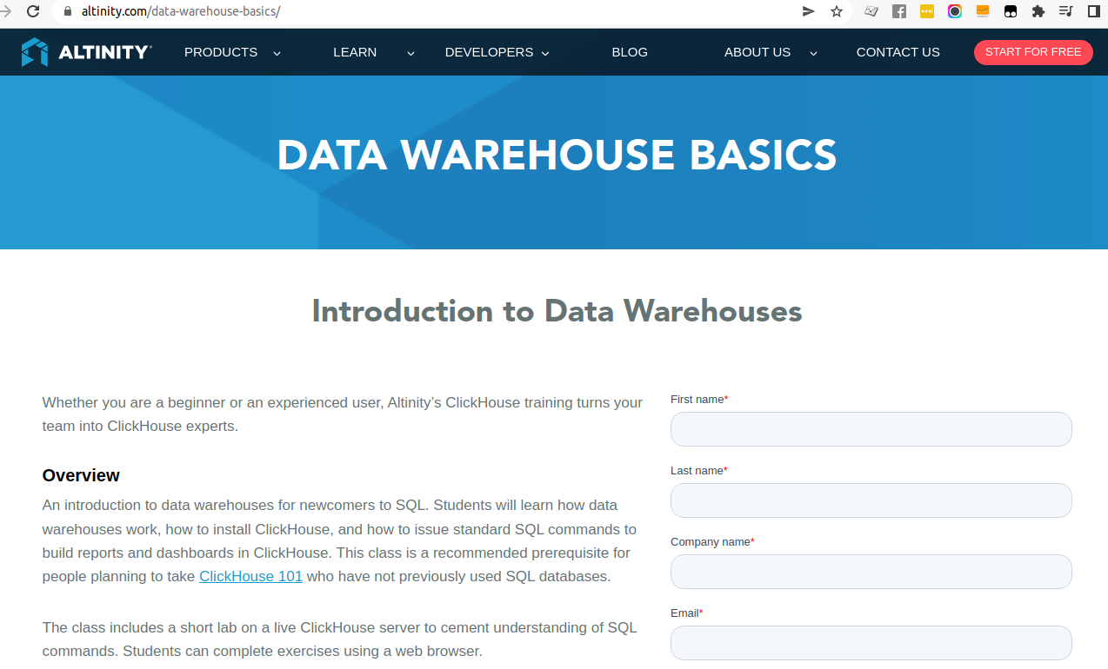
(2) Study/Access to information

Slide 19
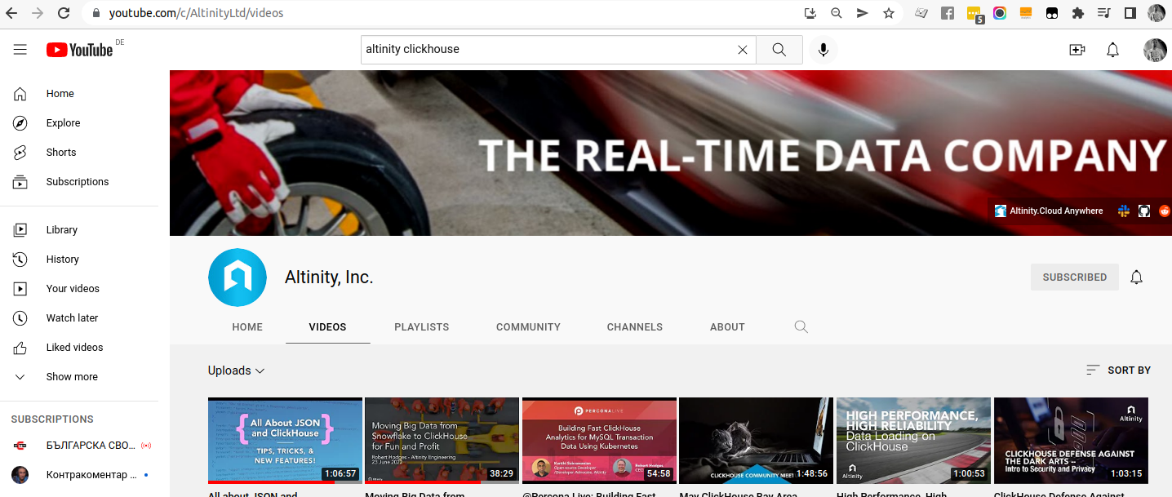
(2) Study/Access to information

Slide 20
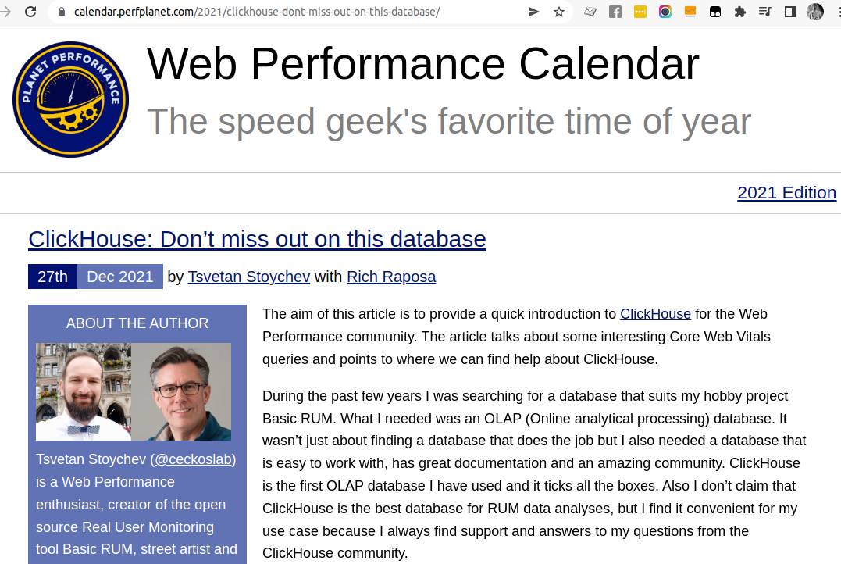
(2) Study/Access to information
I learn best when I try to teach someone!

Slide 21

In closing
Kudos for the great ClickHouse community!

Slide 22
But where to focus first?

Slide 23
The END

